Slide 1
MACHINE TOOLS

Slide 2
Define a machine tool
A machine tool may be defined as a power driven machine which accomplishes the cutting or machining operations in it.
Examples: Lathe
Milling machine,
Grinding machine,
Drilling machine,
Planning machine etc.

Slide 3
Define a lathe
A lathe is a machine tool generally employed
produce circular objects.
Almost all the operations that can be performed on
other machine tools like
drilling machine,
milling machine,
shaping machine can be performed on a lathe.

Slide 4
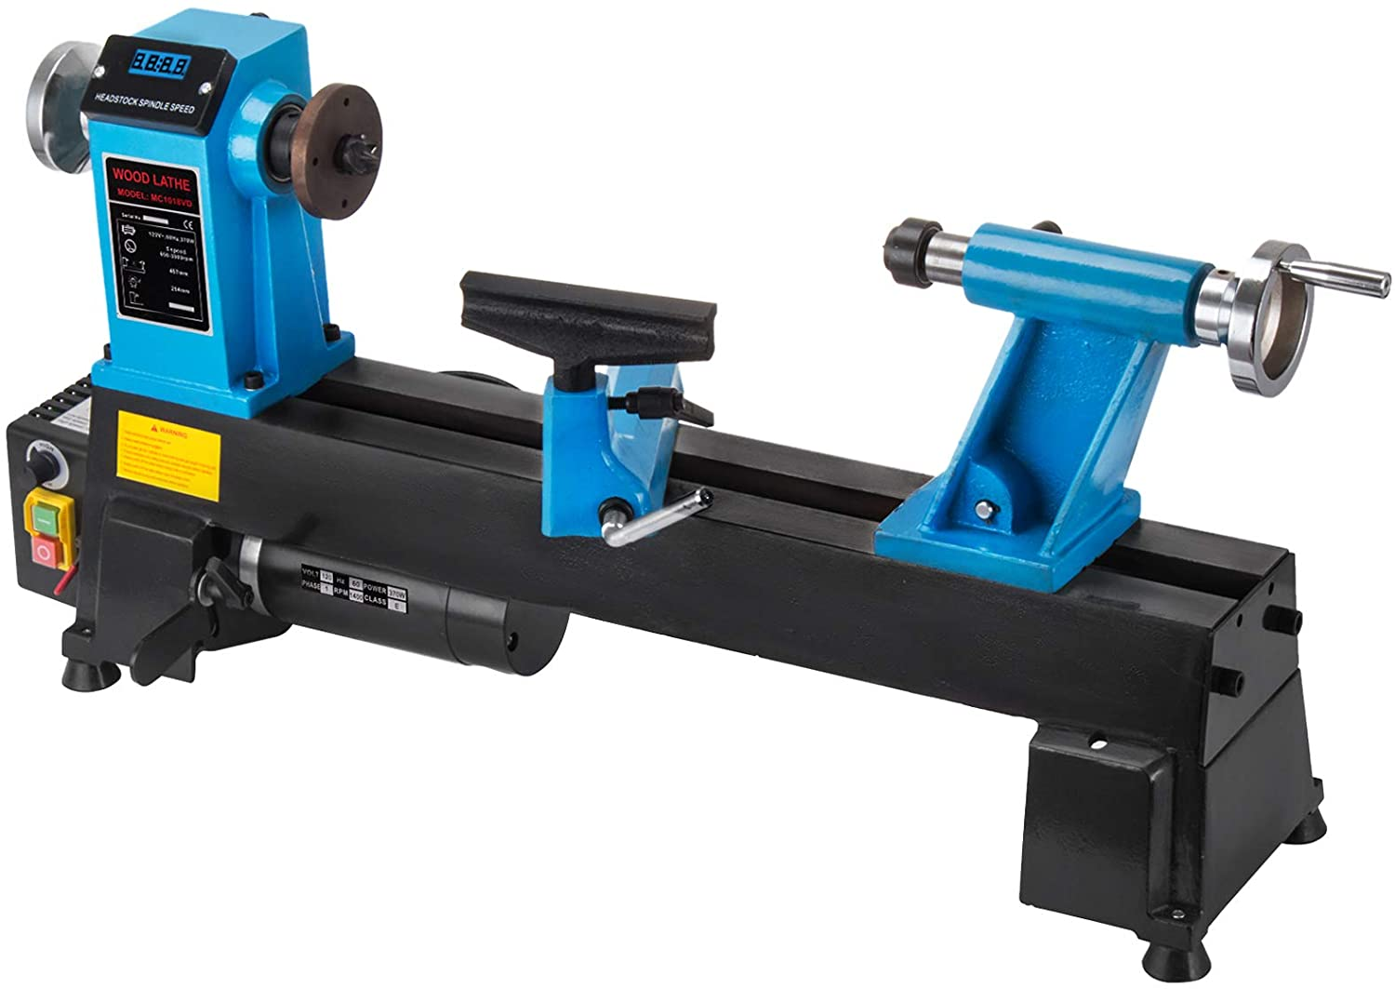

Slide 5
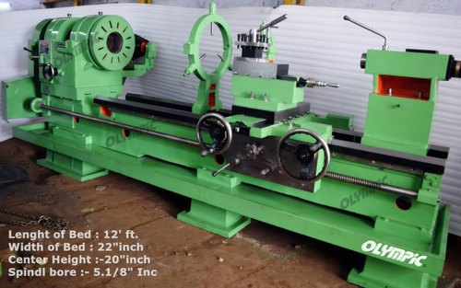

Slide 6
Lathe classification
Based on characteristics:
Engine Lathe
Speed Lathe
Turret Lathe
Capstan Lathe
Automatic Lathe
CNC Lathe

Slide 7
Nomenclature of Single Point Lathe Tool

Slide 8
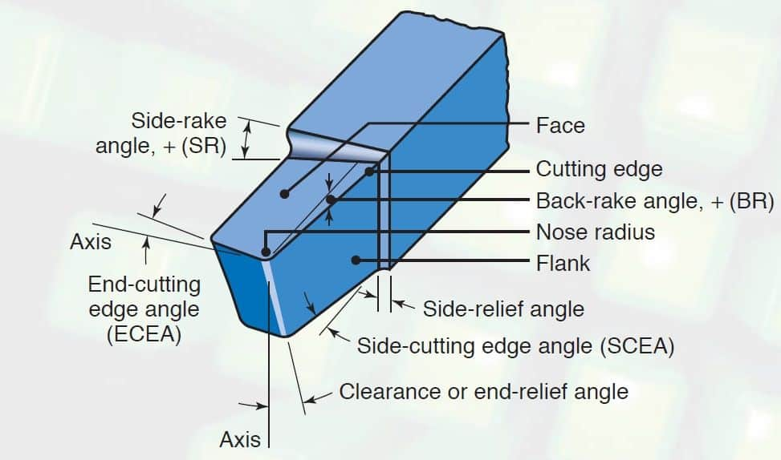

Slide 9
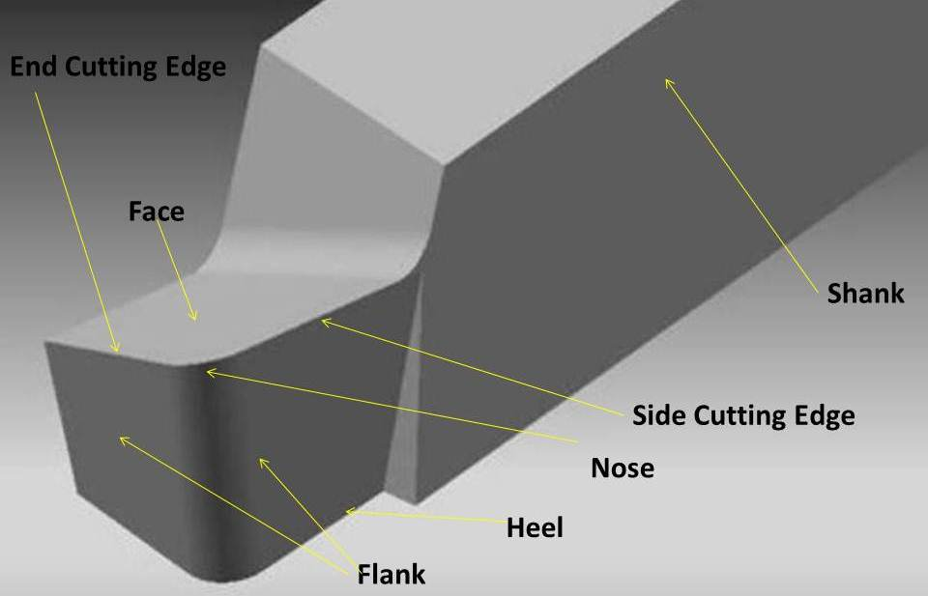

Slide 10
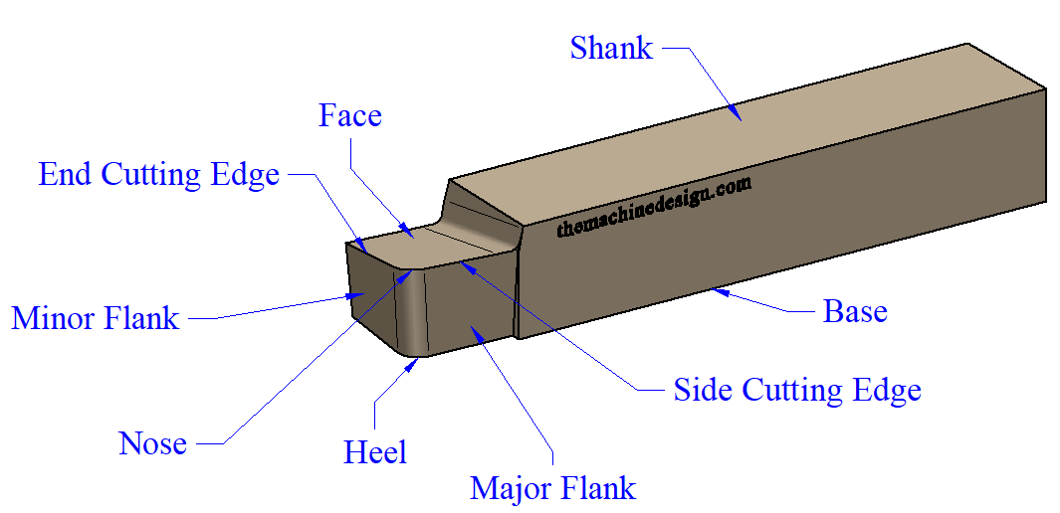

Slide 11
Nomenclature of Single Point Lathe Tool
Point contact between the cutting tool and the work piece
Cutting portion of the tool is formed by,
Face
Cutting edge
Flank
Nose
Base

Slide 12
Nomenclature of Single Point Lathe Tool
Face:
It is the top of the tool and is the surface over which the chip glides over it and away from the work piece
Cutting edge:
It is the part of the tool that does the actual cutting of the metal
Flank:
It is the surface directly below the cutting edge

Slide 13
Nomenclature of Single Point Lathe Tool
Nose:
It is the tip of the tool
It is formed by the side and end edges
Base:
It is the bottom surface of the tool

Slide 14
Nomenclature of Single Point Lathe Tool
The different cutting tool angles are:
Relief or clearance angle
Side relief
End relief
Rake angle
Back Rake angle
Side Rake angle
Cutting edge angle
Side Cutting edge angle
End Cutting edge angle

Slide 15
Relief or Clearance angle:
Ground on the end and side faces of a tool to prevent it from rubbing on the work piece
To enable only the cutting edge to touch the work piece
Side Relief angle:
Angle ground directly below the cutting edge on the flank of the tool
End Relief angle:
Angle ground from the nose of the tool

Slide 16
Rake angle:
Ground on a too to provide a smooth flow of the chip over the tool so as to move it away from the work piece
Back Rake angle
Ground on the face of the tool
Influences the angle at which chip leaves the nose of the tool
Generally 8 - 10⁰
Side Rake angle
Ground on the tool face away from the cutting edge
Influences the angle at which the chip leaves the work piece
A lathe tool has 14⁰ side rake.

Slide 17
Side Cutting edge angle
Ground on a tool so that it can be mounted in the correct position for various machining operations
Approximately 15⁰
Allows flank of the tool to approach the work piece first
Spreads the material over a grater distance on the cutting edge
End Cutting edge angle
Allows the cutting tool to machine close to the work piece during turning operations
Usually 20 - 30⁰

Slide 18
Nose Radius:
Rounded tip on the point of the tool
Functions:
To prevent the sharp fragile tip from breaking during use
To provide a smoother finish on the work piece during machining operation
Preferred nose radius 0.8 mm

Slide 19
Working principle of lathe

Slide 20
Working principle of lathe
cutting tool can remove material in the form of chips from rotating work pieces to produce circular objects
work piece held rigidly by one of the work holding devices known as chuck
V – shaped cutting tool V – shaped cutting tool
produces circular surfaces as shown in the figure.

Slide 21
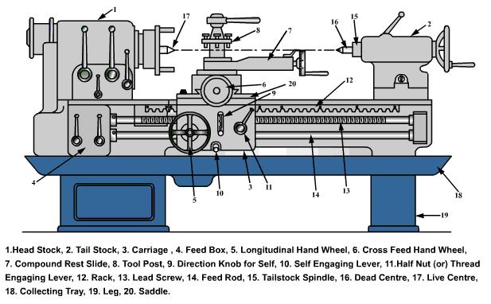
Explain with neat diagram the principal parts of an engine lathe.

Slide 22
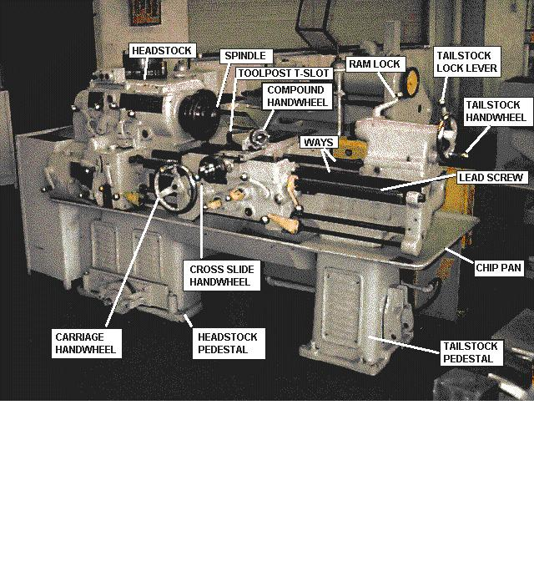

Slide 23
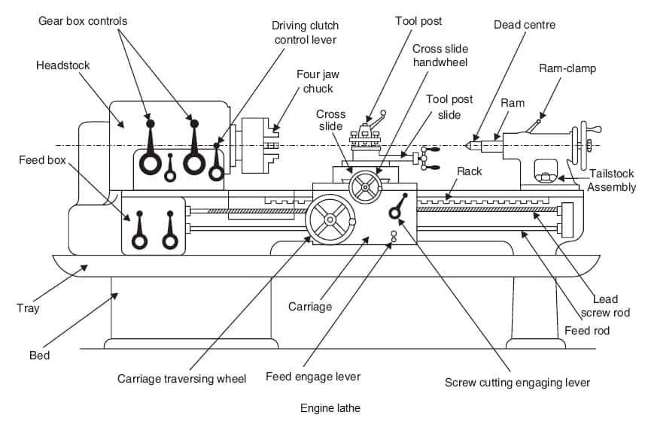

Slide 24
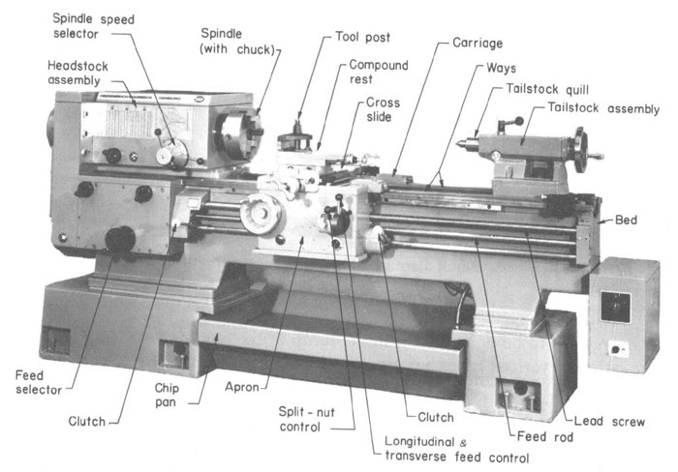

Slide 25
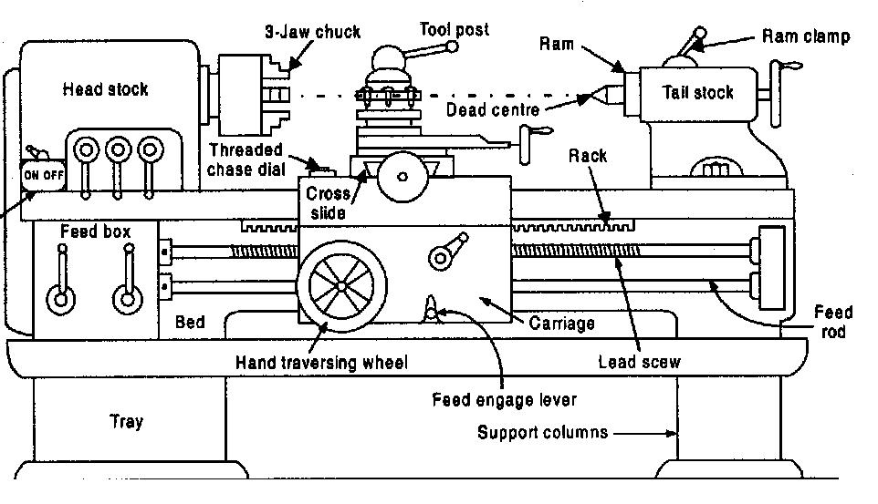
LATHE

Slide 26
Bed:
Is a foundation part of a lathe
supports all its other parts.
two precision machined guide ways formed on the top of the bed
outer guide ways
inner guide ways.

Slide 27
Headstock:
Housing comprising of
feed gear box
stepped cone pulley
Rigidly mounted on the inner guide ways of lathe bed at its left end.

Slide 28
Tailstock:
Movable part of the lathe that carries the dead centre in it.
Used to clamp tools like: Twist drills
Reamers
For making holes, taps and dies for cutting threads.
Mounted loosely on the inner guide ways of lathe bed and can be moved and locked in any position.

Slide 29
Carriage assembly:
Serves to support the tool
Rides over the outer guide
ways longitudinally between headstock
and tailstock.
It is composed of 5 main
parts.
Saddle
Cross slide
Compound Rest
Apron.
Tool post

Slide 30
Saddle
H shaped casting that slides over set of guide ways
serves as the base for the cross slide.
Cross slide
mounted on the saddle
enables the movement
of the cutting tool laterally
across the lathe bed by
means of cross feed hand wheel.

Slide 31
Compound Rest
Mounted on the top of the cross slide
Supports the tool post.
Can be swiveled to any
angle in the horizontal
plane
to facilitate following
operations:
taper turning
threading operations
Moved manually by the compound rest feed handle independent of the lathe cross feed.

Slide 32
Apron
Mounted on the front of the saddle
Beneath it and houses
- Carriage
- Cross slide mechanisms
The apron hand wheel moves carriage manually by
means of the rack and pinion gears.

Slide 33
Tool post
Mounted on the T – slot of the compound rest.
Clamps the tool holder in the proper position for
machining operations.

Slide 34
Lead Screw:
A screw rod which runs longitudinally in front of the lathe bed.
The rotation of the lead screw moves the carriage to and fro longitudinally during thread cutting operation.

Slide 35
Feed rod:
A stationary rod mounted in front of the lathe
bed
Facilitates longitudinal movement of carriage
during turning, boring and facing operations.

Slide 36
Main drive:
An electric motor mounted in the left leg of the lathe in
conjunction with the transmission system like belt or
gear drive from the motor to the spindle i.e. from main
drive of the lathe.

Slide 37
Cone pulley and back gear:
Cone pulley which drives the main spindle is
driven by the motor.
Various spindle speeds can be obtained by shifting the belt on different steps of the cone pulley.
Spindle speeds can be further varied using a back gear arrangement.

Slide 38
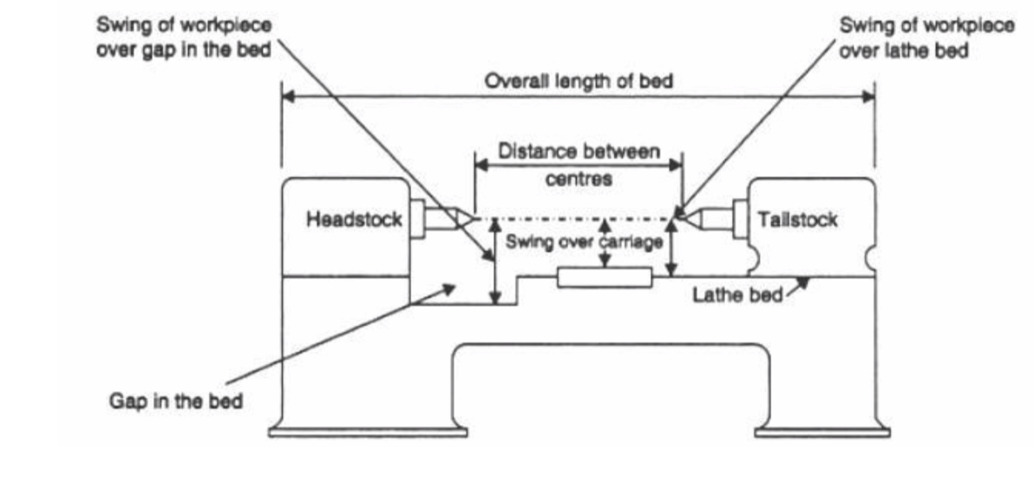
Neat sketch highlight the specification of a lathe.

Slide 39
Specification of a lathe
Distance between centers:
Maximum distance that can be obtained between the lathe centers
Represents the maximum length of the work piece that can be held between centers.
Overall length of the bed:
Maximum length of the bed starting from the head stock end to tailstock end.
Swing diameter over the bed:
Largest diameter of the work piece that can be rotated without touching the bed.
Swing diameter over a gap in the bed:
Maximum diameter and the width of a work piece that can be mounted between the centers.

Slide 40
Name the various operations that can be conducted on a lathe.
The various operations that can be conducted on a lathe
are:
Turning
Taper turning.
Thread cutting.
Boring.
Facing.
Drilling.
Reaming
Knurling.
Milling.
Grinding.

Slide 41
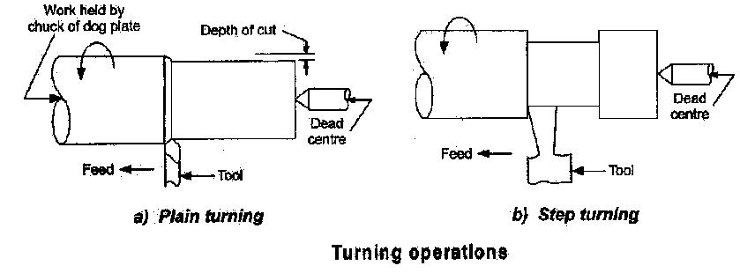
Plain turning operation a with neat sketch.
Plain Turning:
The process of metal removal from the cylindrical jobs is
called straight or plain turning.
Cross slide and the carriage are used to perform turning
operations.
Plain turning operation is performed in two steps.
Rough turning (Roughing)
Finish turning (Finishing)

Slide 42
Step turning operation a with neat sketch.
A step turning operation is illustrated in the as shown figure.
Performed using a wide tool after the plain turning
operation.
The work is held in between the lathe centers or
with the chuck
The tool is held at the height of the axis of the work.
The depth of cut to obtain the step on the cylinder
is provided by cross slide movement and feed by
the carriage movement.
This operation is performed manually.

Slide 43
What is taper turning operation in lathe?
Taper turning involves producing a conical surface on a
cylindrical surface in lathe.
A taper surface can be produced either by,
Rotating the job normally and feeding the tool at some angle (like in compound rest swivel method)
Rotating the job at an off–set angle and feeding the tool normally (like in tail stock set – over method).

Slide 44
Methods of taper turning:
Swiveling the compound rest.
Tailstock set over method.
Taper turning attachment method.
By using form tool.

Slide 45
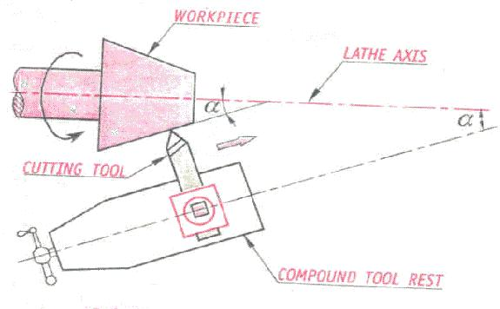
Explain the principle of taper turning by swiveling compound tool rest method.

Slide 46
The principle of taper turning operation by swiveling
the compound rest method is as shown in the figure.
In this method the job is rotated on the lathe axis,
Tool feeding is done at an angle, by the swiveled
compound rest.
To assist in swiveling at particular angle, the base of the compound rest is graduated in degrees.

Slide 47
The taper angle i.e. the angle at which the compound
rest to be rotated is calculated as below.
tan α =
where, α = half taper angle ( simply taper angle ), degrees
D = larger diameter of the taper in mm.
d = smaller diameter of the taper in mm.
L = length of the taper in mm.
By calculating the taper angle, the compound rest can be swiveled to the angle.
The tool feeding is done only by the compound rest handle so that the tool moves at the set angle only.

Slide 48
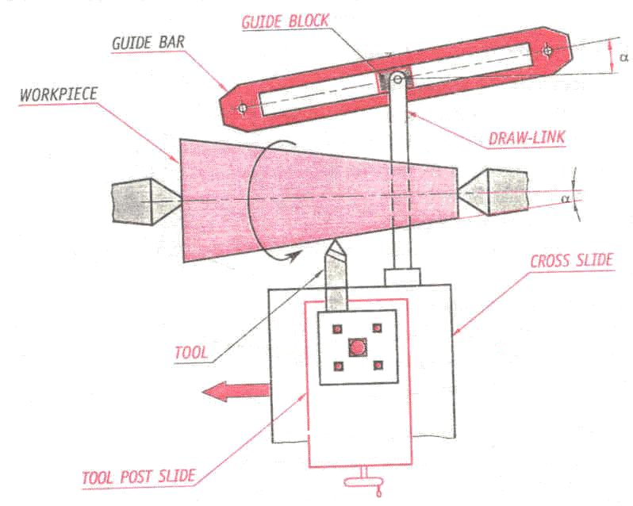
Taper turning using Taper Attachment

Slide 49
Taper turning using Taper Attachment
It is used to cut both internal and external tapers
Consists of a bracket, connected to the rear side of the lathe bed
A guide bar is mounted over the bracket
Guide bar is swiveled in the horizontal plane and locked in position
A guide block pivoted to a draw-link will slide in the longitudinal slot in the guide bar
The draw-link is connected firmly to the cross-slide
Tool is mounted on the tool post slide
The cross slide is allowed to move freely on its ways
This is done by loosening the cross feed screw and the engaging nut

Slide 50
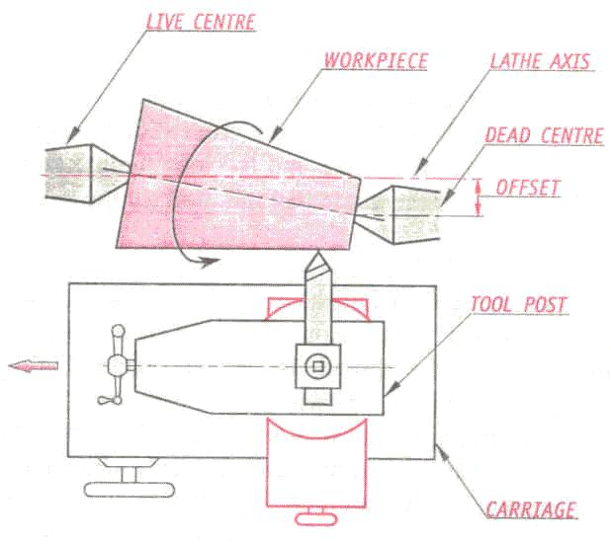
Taper turning by Tailstock set over method

Slide 51
Taper turning by Tailstock set over method
This method is also known as Offsetting the Tailstock
Most common method for taper turning
Best suited for long work pieces having less taper
Only external tapers can be produced
Amount of offset is limited by the size of the tailstock
Working:
The tailstock centre is set out of alignment, as a result
Axis of the work piece gets inclined at an angle to the longitudinal movement of the tool
Movement of the is parallel to the lathe bed
Entire carriage has to be moved parallel to the lathe bed
Now carriage is moved to cut the taper
This produces taper on the long work pieces

